Slide 1

2026
COMPANY
PROFILE
Security • ICT • Smart Technology Solutions

Slide 2


Slide 3

Table of
Content
01 Welcome to our company
02 About us
03 Our mission & vision
04 Our services
05 Selected projects 1 2026
06 Selected projects 2 2026
07 Our Goals
08 Our clients
09 Tech partners
10 Department chart
11 Certification

Slide 4

01
WELCOME TO OUR COMPANY
Welcome to HAWL Technologies PLC — an Ethiopian technology company committed to delivering reliable, innovative, and value-driven solutions. We bring together quality technology, technical expertise, and a deep understanding of our market to help organizations protect, connect, and operate more effectively. As we continue to grow, our commitment remains simple: to build trusted partnerships, deliver professional solutions, and create lasting value through technology. Welcome to HAWL Technologies — Technology You Can Trust.

Slide 5

02
ABOUT US
Hawl Technologies PLC is an Ethiopian technology solutions company providing reliable products, integrated systems, and professional project solutions across Security, ICT Infrastructure, Networking, Audio-Visual, Electrical, and Smart Technology solutions. We serve government institutions, universities, hospitals, financial institutions, hospitality businesses, and private organizations, supporting clients from technology selection and supply through to installation, configuration, commissioning, and project delivery. Our growing project portfolio demonstrates HAWL’s ability to work across diverse technology requirements and project environments. Through strong supplier partnerships, technical expertise, and a commitment to quality and customer satisfaction, we continue to build HAWL as a trusted technology solutions partner in Ethiopia.

Slide 6

03
OUR VISION
To become Ethiopia’s trusted technology solutions partner, recognized for excellence, innovation, and lasting value.
OUR MISSION
To deliver reliable, innovative, and cost-effective technology solutions through quality products, technical expertise, and trusted partnerships.

Slide 7

04
OUR SERVICES
SERVICE 01 — Security & Surveillance SERVICE 02 — ICT & Network Infrastructure CCTV, video surveillance, access control, biometric systems, and integrated security solutions.
SERVICE 02 — ICT & Network Infrastructure CCTV, video surveillance, access control, biometric systems, and integrated security solutions Enterprise networking, structured cabling, servers, data infrastructure, and IT connectivity solutions.
SERVICE 03 — Smart Classroom & LED solution Interactive displays, smart classroom systems, conference solutions, and professional audio-visual systems. & Indoor and outdoor LED displays, digital signage, large-format visual communication, and display systems.
SERVICE 04 — System Integration & Turnkey Projects End-to-end technology project delivery, including supply, installation, configuration, testing, commissioning, and integration.

Slide 8
05
SELECTED PROJECTS 1
No. | Institution / Client | Project Description
01 | Jimma University | Supply of Network Video Recorders (NVR) and CCTV Camera Systems
02 | Ambo University | Turnkey Supply, Installation & Configuration of CCTV System
03 | Assosa University | Turnkey Supply, Installation & Commissioning of 86-Inch Interactive Flat Panel Displays
04 | Jimma University | Turnkey Supply, Installation, Commissioning & Testing of 15 m² Outdoor LED Display and Audio-Visual Equipment
05 | Dire Dawa University | Supply of Electrical Cables and Distribution Boards
06 | Dire Dawa University | Supply & Installation of Biometric Attendance System
07 | Haramaya University | Procurement & Supply of Electrical Materials
08 | Ras Hotel | Supply, Installation & Commissioning of Full Surveillance System

Slide 9
06
SELECTED PROJECTS 2
No. | Institution / Client | Project Description
09 | Ambo Referral Hospital | Supply of Dell PowerEdge R730 2U Rack-Mountable Server
10 | Animal Science Institute | Supply of Automatic Transfer Switch (ATS)
11 | Nib International Bank | Fiber to Copper Media Converter
12 | Federal High Court | Supply of Mobile Phones
13 | Salale University Referral Hospital | Supply of Electrical Cables
14 | Jimma University | Supply of 256-Channel NVR and ICT Equipment
TOTAL — Projects with Stated Values

Slide 10

07
OUR GOLS
GOAL 01 — Customer Excellence Deliver reliable solutions and professional service that create lasting customer value..
GOAL 02 — Technology Leadership Become a trusted leader in security, ICT, and integrated technology solutions in Ethiopia.
GOAL 03 — Strategic Partnerships Build long-term partnerships with leading global technology manufacturers and solution providers.
GOAL 04 — Project Excellence Strengthen our ability to deliver high-quality, efficient, and scalable turnkey technology projects.
GOAL 05 — Innovation & Growth Adopt emerging technologies and continuously expand our solutions to meet evolving market needs.
GOAL 06 — Sustainable Expansion Build a strong, scalable Ethiopian technology company with the people, systems, and capabilities to serve customers nationwide.

Slide 11








08
OUR CLIENTS
JIMMA UNIVERSITY
NIB BANK
AMBO UNIVERSITY
DIREDAWA UNIVERSITY
HARROMAYA UNIVERISTY
FEDERAL HIGH COURT
ANIMAL SCIENCE INSTITUTE
ASOSA UNIVERSITY
RAS HOTEL

Slide 12









09
TECH PARTNERS
HIK VISION
WD
CANOVATE
HUAWEI
DAHUA
FORTINET
SYNOLOGY
SEAGATE
DELL
CISCO

Slide 13
10
DEPARTMENT CHART
ADMINISTRATION
BUSINESS DEVELOPMENT
OPRATION
DIGITAL MARKETING
FINANCE
IMPORT

Slide 14


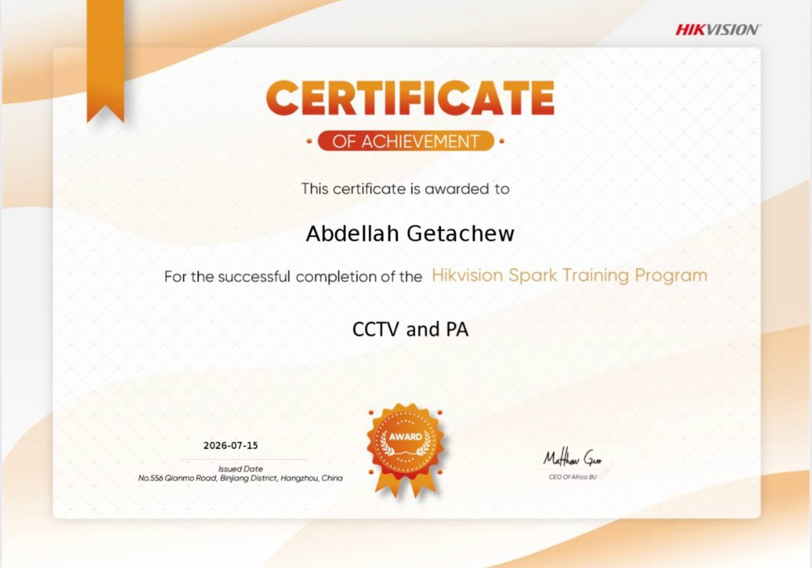




11
CERTIFICATIONS

Slide 16


CONTACT US
HAWL TECHNOLOGIES PLC
📍 Bole Dembel 2nd Floor, SFS 017
📞 +251 911 251 790 | ☎ +251 11 558 2204
✉ info@hawltechnologies.com
🌐 www.hawltechnologies.com
Security • ICT • Smart Technology Solutions

